Slide 1

Sampling

Slide 2
What is sampling?
Sampling is the process of selecting a segment of the population for investigation.
This definition is similar to that of a sample: a subset of the population of interest. Or a group of people, objects, or items that are taken from a larger population for measurement.
The term population in research entails the universe of units from which the sample is to be selected. The term ‘units’ is employed because it is not necessarily people who are being sampled—the researcher may want to sample from a universe of nations, cities, regions, firms, etc

Slide 3
Important concepts in sampling
There are two types of sampling methods:
Probability and non-probability sampling
Probability sample: a sample that has been selected using random selection so that each unit in the population has a known chance of being selected.
It is generally assumed that this method is employed to select the sample from the population, it is likely to result into a representative sample.
Representative sample: a sample that reflects the population accurately so that it is a microcosm of the population.
The representative sample is more likely to minimize sampling error
Sampling error is error in the findings deriving from research due to the difference between a sample and the population from which it is selected

Slide 4
Probability sampling designs
There are basically four types of probability sampling designs. The common denominator among all the sampling design types is randomization or random selection:
Simple random sample
Systematic sampling
Stratified random sampling
Multi-stage cluster sampling

Slide 5
Simple random sampling
The simple random sample is the most basic form of probability sample
In simple random sampling, each member of the population of interest has an equal chance of being selected into the sample.
This is the ideal sampling method. It has the highest degree of eliminating bias and thus ensuring representativeness of the population.
However, one of the biggest caveats of simple random sampling is that it requires the existence of a sampling frame from which the sample should be derived.
The Sampling frame is the list of all possible elements of the population

Slide 6
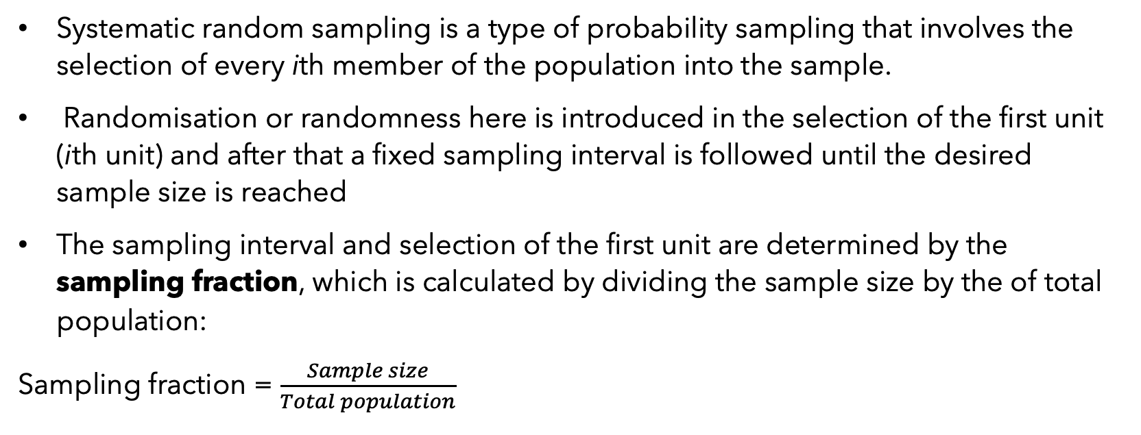
Systematic randon sampling
Systematic random sampling is a type of probability sampling that involves the selection of every ith member of the population into the sample.
Randomisation or randomness here is introduced in the selection of the first unit (ith unit) and after that a fixed sampling interval is followed until the desired sample size is reached
The sampling interval and selection of the first unit are determined by the sampling fraction, which is calculated by dividing the sample size by the of total population:
Sampling fraction = $\frac{Sample size}{Total population}$

Slide 7
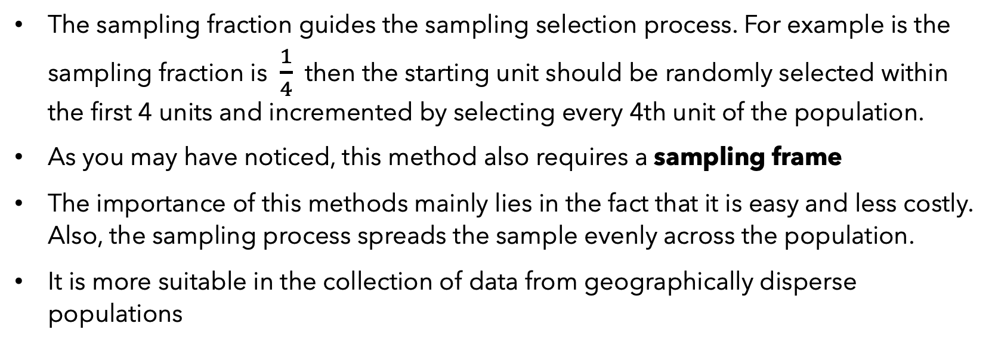
Systematic random sampling
The sampling fraction guides the sampling selection process. For example is the sampling fraction is $\frac{1}{4}$ then the starting unit should be randomly selected within the first 4 units and incremented by selecting every 4th unit of the population.
As you may have noticed, this method also requires a sampling frame
The importance of this methods mainly lies in the fact that it is easy and less costly. Also, the sampling process spreads the sample evenly across the population.
It is more suitable in the collection of data from geographically disperse populations

Slide 8
Stratified random sampling
Stratified sampling method is a type of probability sampling method involving the division of the population into smaller sub-populations called strata and selecting elements from each strata in a proportionate fashion.
This method is often used to obtain a representative sample from the population which does not constitute a homogeneous whole.
The procedure for stratified sampling usually begins with determining the proportion of the total sample size to be drawn from each stratum. Followed by randomly selecting elements from each stratum

Slide 9
Stratified random sampling
For example if we are interested in studying public perceptions on violence against women and we have anecdotal evidence suggesting that there are gender differences in public perception, we may want to stratify our sample in order to have an equal proportion of women and men.
We will start with determining the proportion of women and men to be selected in our sample (in this case 50% women and 50% men) and then we randomly select the required number of women and that of men.

Slide 10
Cluster sampling
We have seen in the earlier sampling methods that they require a sampling frame, which is sometimes unattainable due to the total area of interest being too large.
In such situations, the researcher can opt for cluster sampling. This sampling method typically involves dividing the total population of interest into separate and relatively small groups known as clusters. Then a random sample of clusters is selected with the ultimate sample consisting of all the units in the sampled clusters
Area sampling is the most popular version of cluster sampling whereby a geographical area is sub-divided into primary sampling units (PSUs) which are considered as clusters

Slide 11
Multi-stage cluster sampling
Multistage cluster sampling is an extension of cluster sampling and it contains two or more stages in the sampling process.
In other words, multistage basically means the division of large clusters into smaller clusters at several stages to make data collection more feasible.
Multistage cluster sampling is complex and may also compromise precision but it may be the only possible methods of sampling in larger studies which extends to big geographical areas like national surveys.
In this case, clusters can be provinces, districts, constituencies, villages and households

Slide 12
Importance of probability sampling
Used in quantitative studies
Seeks generalisations from the sample to the population
Tends to be much more accurate and reliable
Scientific in nature because of standard procedures of arriving at the sample

Slide 13
Non-probability sampling methods
There are times when probability sampling wouldn’t be appropriate even if it were possible. In such situations non-probability sampling methods are more suitable
The term ‘non-probability sampling’ is essentially an umbrella term to capture all forms of sampling that are not conducted according to the canons of probability sampling outlined above.
Types include: convenience, purposive, snowball and quote sampling

Slide 14
Convenience sampling
A convenience sample is one that is simply available to the researcher by virtue of its accessibility. Imagine that a researcher who teaches education at a university is interested in the kinds of features that teachers look for in their headmasters.
The researcher might decide to interview any teacher that he comes into contact with.
The findings may prove quite interesting, but the problem with such a sampling but this sample is biased and not representative….is not generalisable.

Slide 15
Purposive sampling
Sometimes it’s appropriate to select a sample on the basis of knowledge of a population, its elements, and the purpose of the study. This is called purposive or judgemental sampling.
purposive (judgmental) sampling A type of nonprobability sampling in which the units to be observed are selected on the basis of the researcher’s judgment about which ones will be the most useful or representative.
Topic: internet usage among young people in Zambia

Slide 16
Snowball sampling
This procedure is appropriate when the members of a special population are difficult to locate, such as homeless individuals, migrant workers, or undocumented immigrants, drug traffickers.
In snowball sampling, the researcher collects data on the few members of the target population he or she can locate, then asks those individuals to provide the information needed to locate other members of that population whom they happen to know
Sometimes, the term chain referral is used in reference to snowball sampling and other, similar techniques in which the sample unfolds and grows from an initial selection

Slide 17
Quota sampling
Quota sampling is comparatively rarely employed in academic social research, but is used intensively in commercial research, such as market research and political opinion polling.
The aim of quota sampling is to produce a sample that reflects a population in terms of the relative proportions of people in different categories, such as gender, ethnicity, age groups, socio-economic groups, area of residence, etc.
However, unlike a stratified sample, the sampling of individuals is not carried out randomly, since the final selection of people is left to the interviewer

Slide 18
END

